Slide 1

Pont Du gard
By Alex

Slide 2
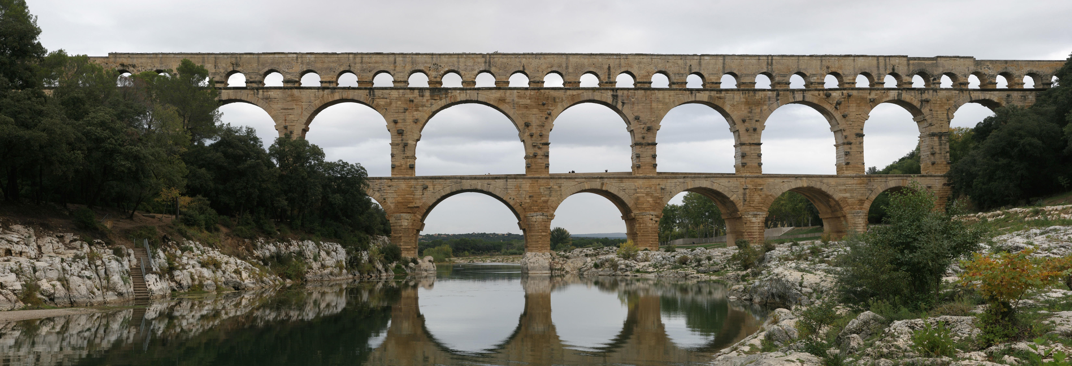
facts
It was built in Southern France
It was built around 19 BC and took 15 years to build. It is 2000 years old!
It is an aqueduct

Slide 3
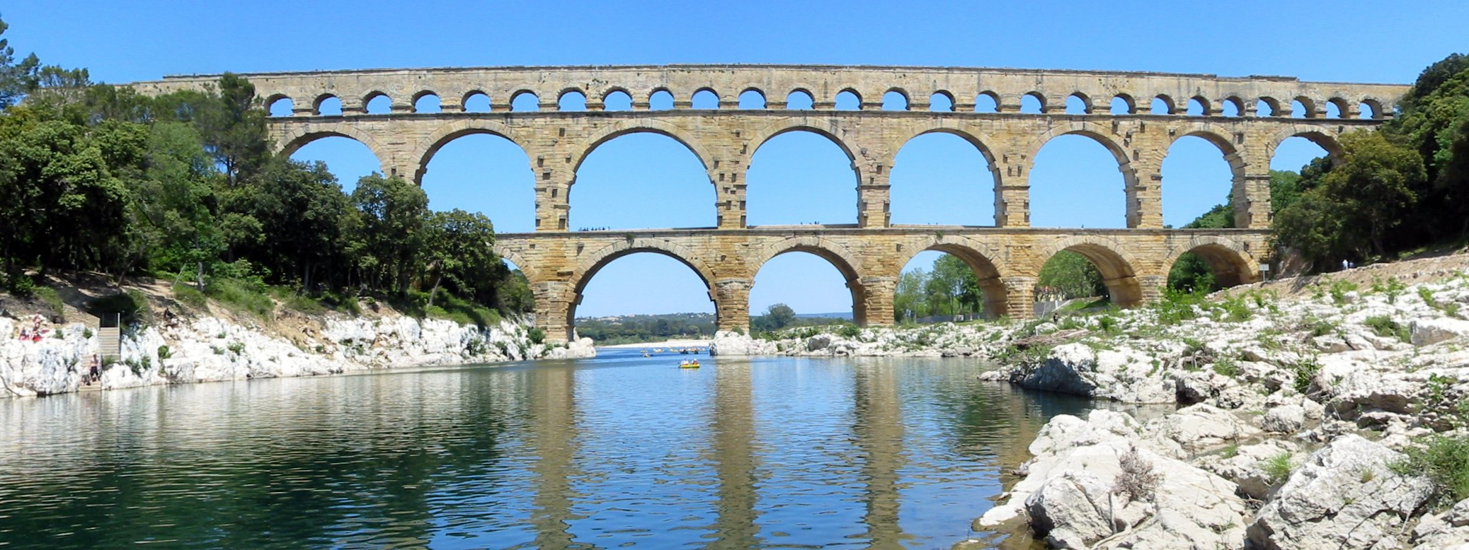
Length and height
Height: 160 feet tall
Length: 902 feet long

Slide 4

Pont du gard

Slide 5


Comparison
Height
Length
The Changyang Bridge in China is 691 feet shorter in length than The Pont du Gard
The Pont du Gard is 691 feet longer than the Changyang Bridge in China.
The Changyang Bridge in China is
64.4 meters long (211 feet)
10.6 meters tall
The Pont du Gard bridge in southern France is 902 feet long (274 meters)
160 feet tall

Slide 6
Researched and Produced by
Alex
Buck Lake Elementary
Tallahassee FL
Thank you
Just fun facts.com

